Slide 1


























Test Your Knowledge!
In Partnership With

Slide 2




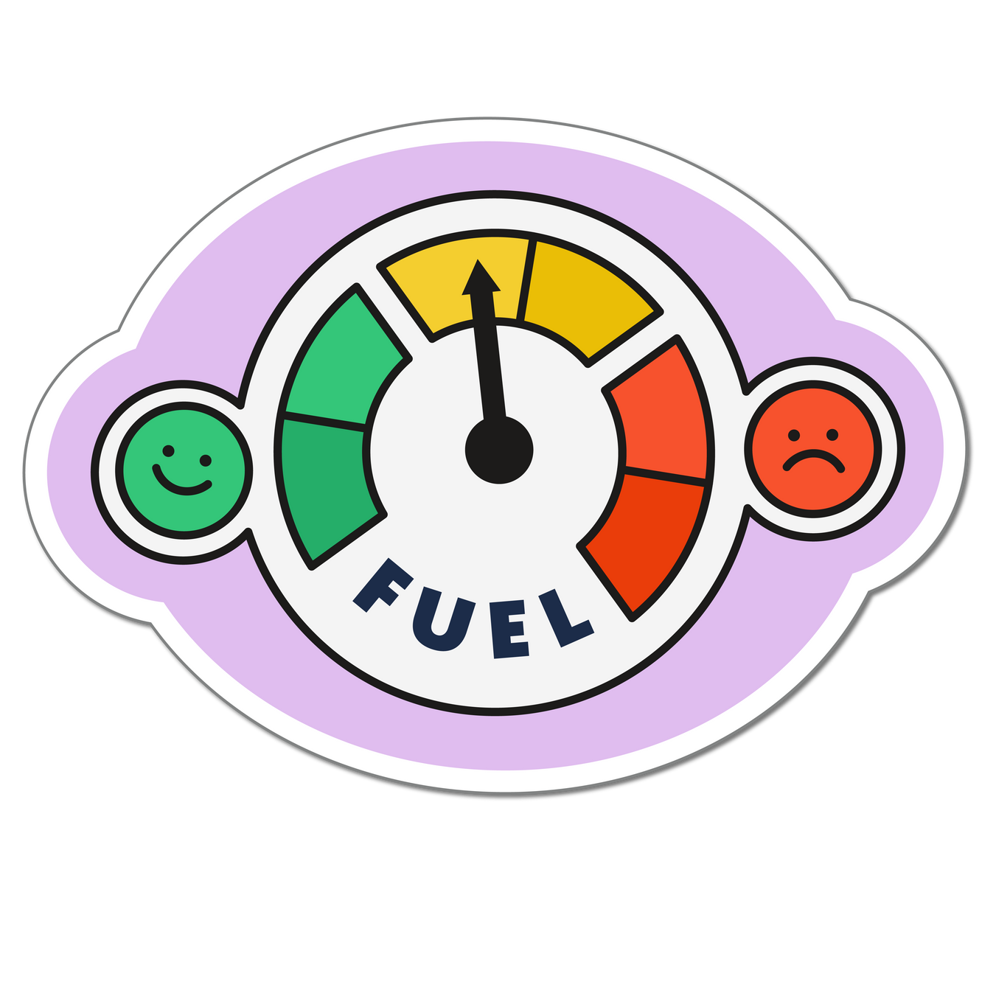







01
02
03
When fossil fuels are burned, what is released?
04
05
06

Slide 3

01
02
03
Any of these are correct:
Greenhouse gases, Carbon dioxide, Carbon emissions
04
05
06

Slide 4
01
02
Fossil fuels such as natural gas, coal, and oil are burned to produce energy, like heat and electricity. When these fuels are burned, they release greenhouse gases (including carbon dioxide) into the atmosphere.
Greenhouse gases trap heat and stop it from escaping the planet, this is making earth warmer and creating climate change.
Good news!
In 2024, the last coal power plant in the UK closed, marking a major step away from fossil fuel usage in electricity generation.
03
04
05
06

Slide 5

01
02
True or false?
03
Buying items second-hand can help to keep carbon emissions down.
04
05
06

Slide 6
01
02
03
True!
04
05
06

Slide 7
01
02
One person's waste can be another person’s treasure! Buying second-hand is a great way to prevent carbon emissions and give no longer wanted items that could be headed for landfill a second lease of life.
The waste hierarchy encourages us to reduce, reuse and recycle, before deciding that an item is to be disposed of.
03
04
05
06

Slide 8

01
02
Place these foods in order of their carbon emissions:
Chicken
Bananas
Chocolate
Milk
Beef
03
04
05
06

Slide 9
01
02
Correct order:
Beef
Chocolate
Chicken
Milk
Bananas
03
04
05
06

Slide 10
01
02
There are many carbon-emitting processes involved in producing food such as farming, feeding animals, processing, transport, and packaging.
Here’s how much carbon is emitted to produce 1kg of these foods:
Beef – 99kg
Dark chocolate – 47kg
Chicken – 10kg
Milk – 3kg
Banana – 1kg
03
04
05
06
Our World in Data

Slide 11

01
02
03
Name one renewable source of energy
04
05
06

Slide 12
01
02
Possible answers:
Solar/solar panels
Wind/wind turbines
Biomass
Hydroelectric/water
Geothermal
03
04
05
06

Slide 13
01
02
In 2022 41.5% of the UK’s electricity came from renewable sources, with wind being the largest contributor at 24.7%.
To slow down global warming and limit the effects of climate change we need to switch from fossil fuels to renewable energy sources.
Good news!
In 2023, wind generated more electricity than gas for the first time in the UK.
03
04
05
06
BBC
BBC

Slide 14

01
02
Which of these things contributes to water’s carbon footprint?
Transporting water
Cleaning water
Heating water
All of the above
03
04
05
06

Slide 15
01
02
03
All of them!
04
05
06

Slide 16
01
02
Water itself doesn’t emit carbon, but for it to be used for drinking and cleaning it needs to be cleaned and transported. These processes all require energy, and generating energy can emit carbon.
As the climate gets warmer, demand for water will increase. Rainwater harvesting and reusing wastewater where possible can help with this.
03
04
05
Sepa
06

Slide 17

01
02
Which of the following releases the least emissions?
Walking/wheeling
Car
Bus
Tram/Train
03
04
05
06

Slide 18
01
02
03
Walking/wheeling produces 0 emissions!
04
05
06

Slide 19
01
02
Carbon emitted by travelling one kilometer can vary widely based on transport type:
Average car – 0.17kgCO2e
Tram/train - 0.03kgCO2e
Bus – 0.11kgCO2e
Walking/wheeling - 0kgCO2e
Good news!
Electric vehicles will become the norm in future, as the UK intends to ban the sale of fuel-powered cars from 2030.
03
04
05
06
BBC

